Slide 1
Fashion Sensei: Virtual Fashion Mentor
Team Members:
Aditi (00314808523)
Purnima Kishore (00514808523)
Ananya Verma (03914811622)
Under the Guidance
of
Dr. Neeraj Garg
H.O.D (AI & ML)

Slide 2
Abstract
This project proposes an exciting technology powered by artificial intelligence and machine learning that has the ability to transform the fashion business by creating personalized designs based on individual style choices and body measurements. The system uses complex machine learning algorithms to analyze large datasets comprised of a variety of fashion designs, trends, and kinds of bodies in order to detect subtle patterns and preferences. Individuals enter their style choices, physique evaluations, and other design specifications using a simple interface.

Slide 3
Introduction
Presenting "Fashion Sensei: Virtual Fashion Mentor" — your one-stop shop for all things stylish and sophisticated!
Fashion Sensei is not just another style technology, it's like having your own personal fashion advisor on the internet. Fashion Sensei is here to help you every step of the way, whether you're a fashion enthusiast who wants to perfect your aesthetic or someone who is just beginning their style adventure.
Individuals interact with the system through a simple interface, where they input their style preferences, physique evaluations, and other design specifications. The system then processes this information and generates personalized fashion designs tailored to each individual's unique preferences and measurements.

Slide 4
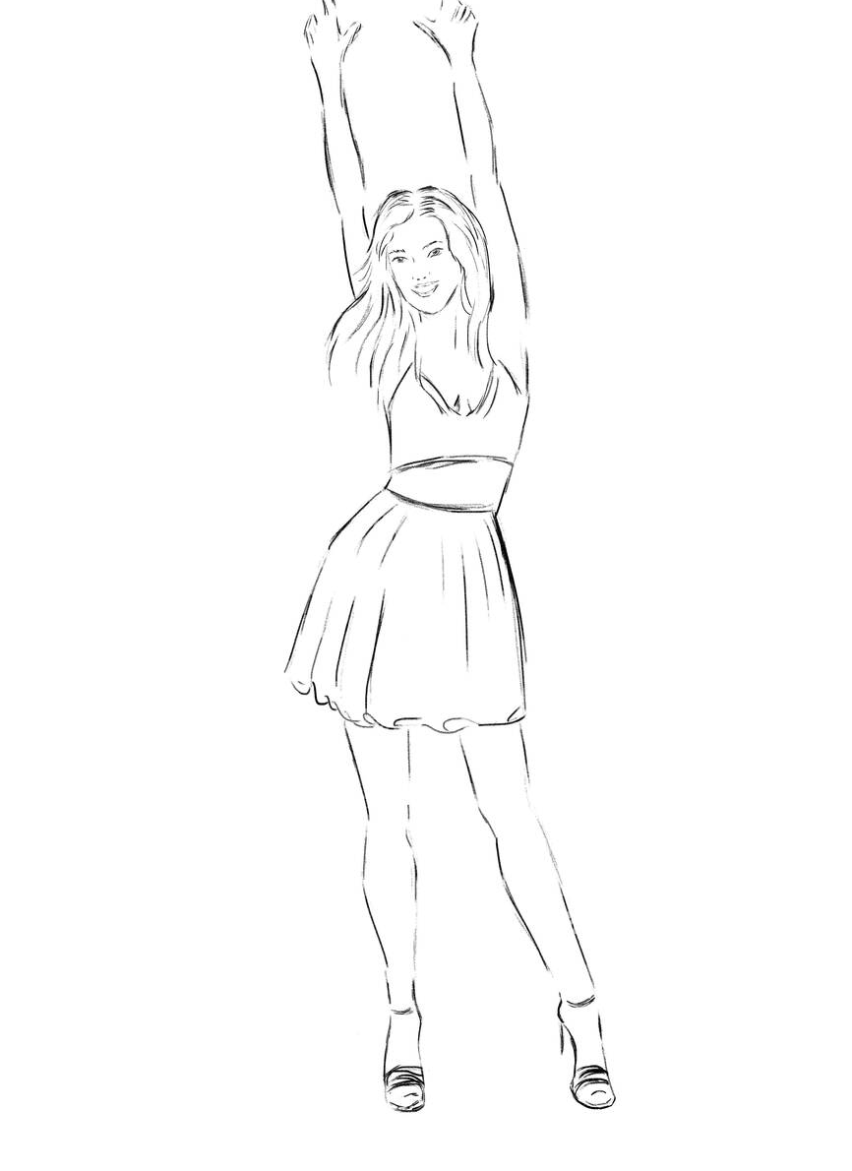
Scope
Gather diverse image datasets of various clothing styles, patterns, and colors.
Develop a method for users to provide accurate measurements, such as user-friendly form.
Develop a style preference model that utilizes Computer Vision (CV) to analyze uploaded images for style, color, and pattern recognition.
Training the models on the curated dataset to learn patterns and correlations between fashion elements and user preferences.

Slide 5
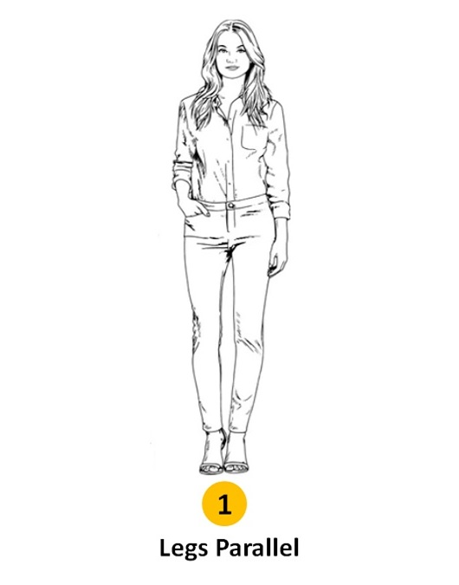
Motivation
The motivation behind our project lies in addressing the limitations of traditional fashion design methods, which often fail to provide personalized clothing options that cater to individual style preferences and body measurements. We aim to empower users to express themselves through fashion in a more personalized, accessible, and enjoyable manner.

Slide 6
Challenges
Availability of large and diverse datasets of fashion images annotated with style preferences and body measurements can be limited.
Designing and training machine learning models capable of generating personalized fashion designs requires sophisticated algorithms and significant computational resources.
Ensuring that the generated fashion designs are diverse, creative, and aligned with individual style preferences.
Defining appropriate metrics for evaluating the performance and effectiveness of the AI-powered fashion design system can be challenging.

Slide 7
Machine Learning
Pytorch
Computer Vision
Tenserflow
Generative Adversarial Networks (GANs)
Technology Stack

Slide 8
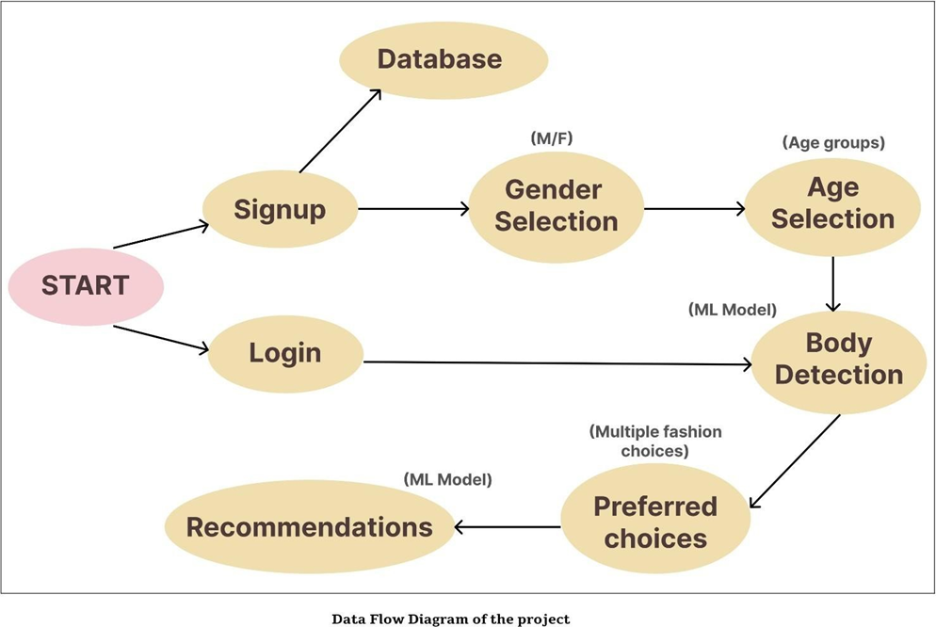
Architecture

Slide 9
features
Personalized Design Creation: Based on a user's physical dimensions and preferred style, the system creates customized fashion designs. Users can input their choices to receive custom designs that suit their taste in color schemes, patterns, types of clothing, and more.
Advanced Machine Learning Algorithms: The research makes use of sophisticated machine learning algorithms to examine large datasets that include a variety of fashion styles and trends. The technology can generate designs that complement users' body types and aesthetic choices because to these algorithms' ability to identify minute patterns and preferences.
User-Friendly Interface: The interface is designed to be intuitive and user-friendly, allowing individuals to input their style choices, physique evaluations, and design specifications effortlessly. Users customize their preferences, and receive personalized design recommendations in a seamless manner.

Slide 10
Real-Time Feedback: In order to make sure that the generated designs live up to users' expectations, the system offers real-time feedback and ideas based on user input. To discover the ideal fit, users can experiment with different design possibilities, fine-tune their preferences, and engage with the system.
Adaptive Recommendations: The system continuously enhances its recommendation engine by learning from user interactions and feedback over time.
Encouraging Creativity: The project encourages people to express their individual sense of style and creativity. The method promotes equality and diversity in the fashion business by democratizing the design process and making unique fashion solutions accessible to people with a variety of body types and stylistic preferences.
Ethical and Sustainable Practices: By encouraging digital fabrication processes, reducing material waste, and strengthening local manufacturing activities, the project places a strong emphasis on ethical and sustainable practices.

Slide 11
Engineering Significance
This project is significant from an engineering standpoint because it has the ability to transform the fashion business by utilizing AI and machine learning technologies.
Algorithm Development: It's critical to create sophisticated machine learning algorithms that can examine big datasets of patterns and fashion designs. To produce personalized designs, these algorithms must effectively interpret and extract relevant patterns and preferences.
Data Processing and Management: Requiring strong data processing and management systems, handling substantial amounts of heterogeneous data is necessary. For the AI models to be accurate and scalable, engineering solutions for effective data retrieval, storage, and preprocessing are crucial.
Interface build: In order to ensure user acceptance, it is essential to build an interface that is easy to use so that people may input their body dimensions, preferred styles, and design options. Usability and engagement are improved by designing a fluid and simple interface that makes it easier for consumers to interact with AI systems.

Slide 12
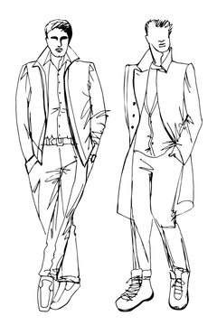
Scalability and Performance: These two factors are critical since the system must be able to manage a high volume of users and process enormous volumes of data in real time.
Constant Learning and Improvement: It is essential that the system be able to keep learning and refining its design suggestions in response to user input and changing fashion trends. In the ever-changing world of fashion, the system's ability to gather feedback, retrain models, and implement adaptive algorithms allows it to remain competitive and current.

Slide 13
Conclusion
The effort offers a ground-breaking solution with the potential to completely transform the fashion industry, representing a huge advancement at the heart of technology and fashion. The suggested method has proven its capacity to accommodate each person's distinct preferences and body type by utilizing artificial intelligence and machine learning, offering a highly customized experience.
Large datasets with a variety of body measurements, fashion designs, and trends are efficiently analyzed by the system. Because of this, it can recognize tiny patterns and preferences, which makes it easier to create customized designs that complement each user's unique style and physical attributes.
shion Sensei heralds a new era when technology acts as a conduit for individual expression and empowerment in the field of style. It symbolizes a paradigm shift in how we view and interact with fashion. Fashion Sensei serves as a light of innovation, encouraging us to rethink the possibilities of personal style in the digital era as we continue to embrace the confluence of fashion and technology.

Slide 14
THANK YOU

